Slide 1





AI VIRTUAL MOUSE

Slide 2
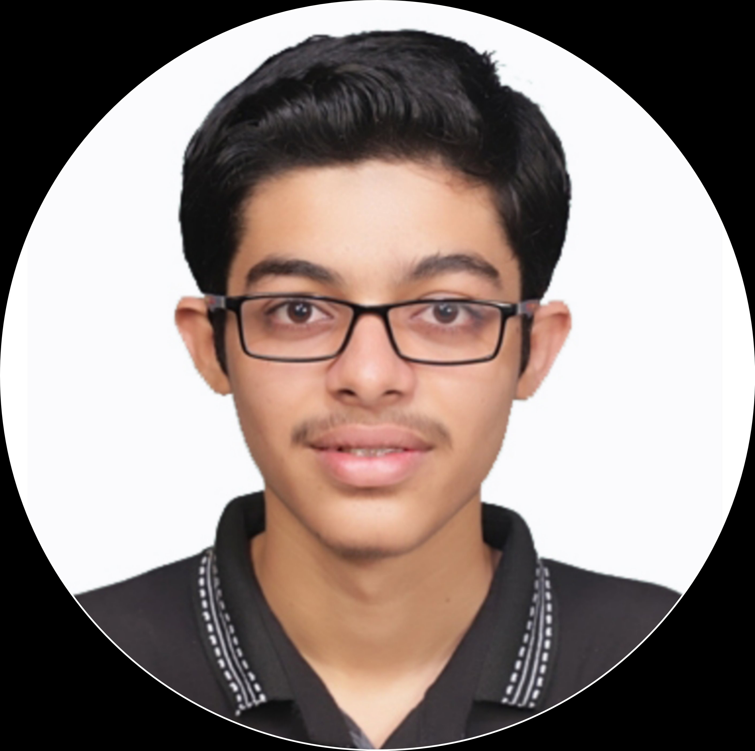
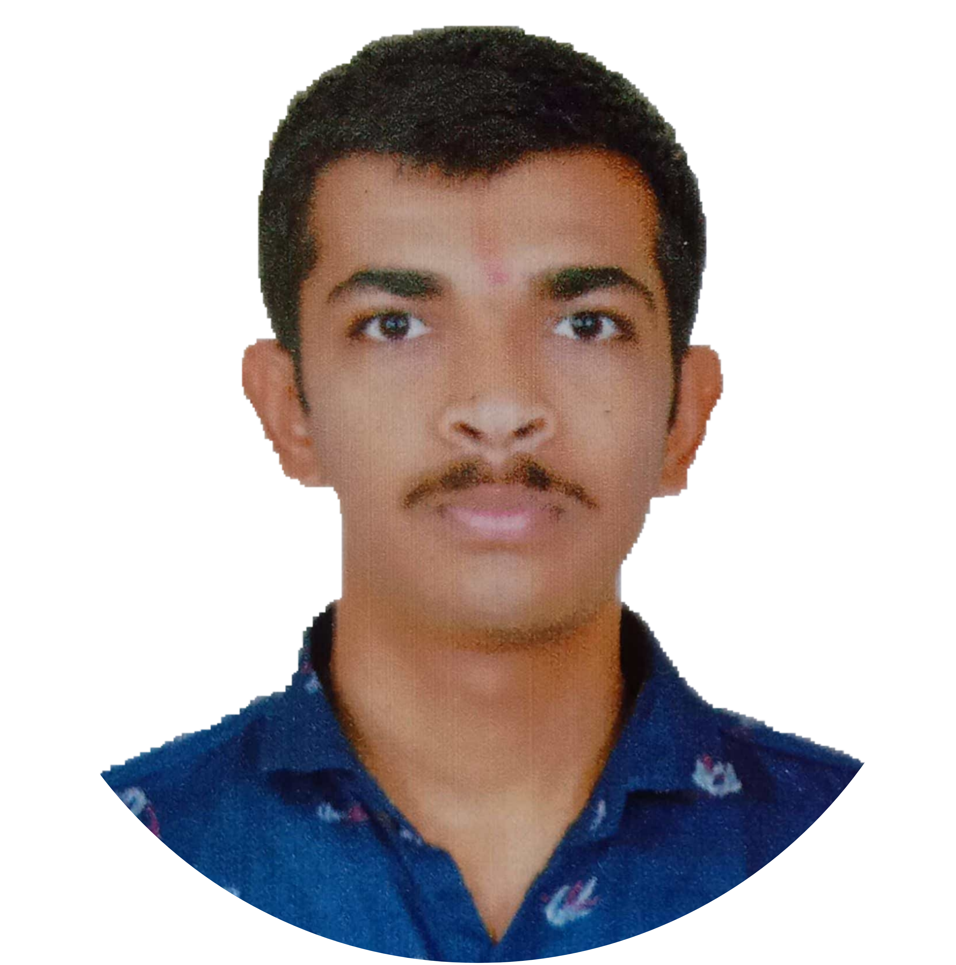




Team Members
Aditya Anasune Group Leader
Lead Strategist
Aditya Patil Assistant Group Leader
Lead Developer
Aditya Suresh Back-end Developer
Documentation Analyst
Aditya Kirar Project Coordinator
Tejas Adsare Data Facilitator
Aditya Bhoite
Project Implementer
Project Guide – Prof. Kiran More

Slide 3
Abstract
As technology evolves, Hand gesture recognition will play a major role in the graphics-oriented world of the future.
Hand gesture recognition allows us to control our system by showing our hands in front of an optical sensor
How convenient would it be if we could just point our fingers at the computer, move it across the screen, and see the cursor move along with it, that is exactly what a virtual mouse achieves.

Slide 4
Introduction
Our motive is to build a program that when executed, tracks the human hand using a webcam
We achieved this by building a Hand-Tracking Module, that contains necessary codes required to track the motion of our fingers.
Next, we developed a code that detects the human hand by capturing video footage from a webcam
Then we added various functions that the virtual mouse can perform.

Slide 5
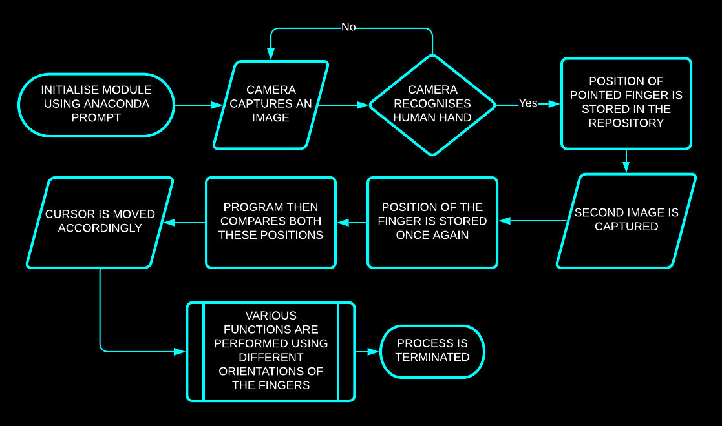
Block Diagram

Slide 6
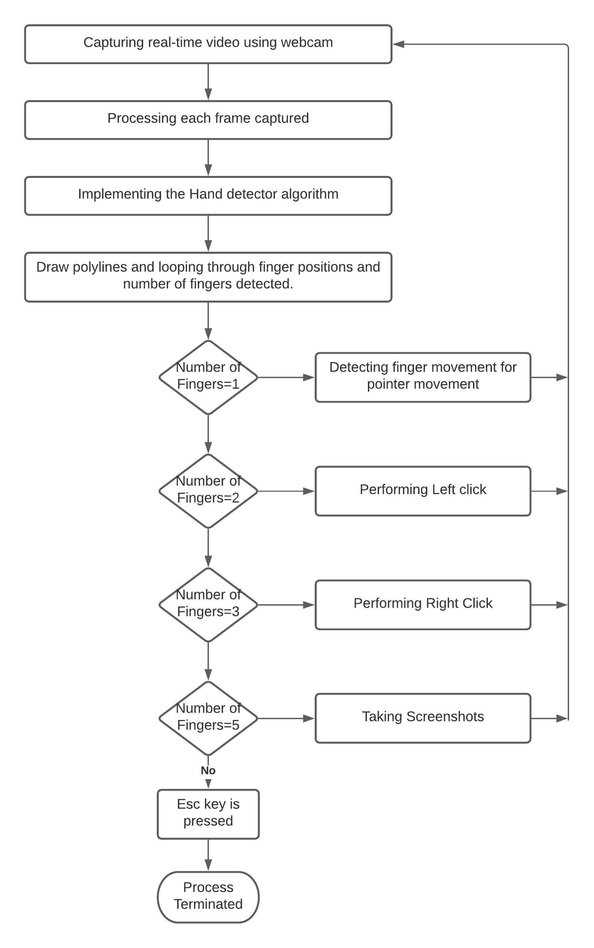
Block Diagram (code)

Slide 7
Result
We have successfully implemented Hand-Tracking module, which detects and tracks the human hand.
It also creates a rectangle around the general area of hand movement, resizes and moves in sync with it.
It also detects the number of fingers we are pointing at the camera
Various functions are thus performed with varied orientations of fingers.

Slide 8
References
VIRTUAL MOUSE USING HAND GESTURE, Abhilash S , Lisho Thomas, Naveen Wilson, Chaithanya C,e-ISSN: 2395-0056, p-ISSN: 2395-0072
Abhik Banerjee, Abhirup Ghosh, Koustuvmoni Bharadwaj,” Mouse Control using a Web Camera based on Color Detection”,IJCTT,vol.9, Mar 2014.
Rashmi Adatkar,Ronak Joshi, et.al,(2017).Virtual Mouse, Imperial Journal of Interdisciplinary Research (IJIR), Vol-3, Issue-4.
G. Saravanan, G. Yamuna, S.Nandhini(2016).Real time implementation ofRGBtoHSV/HSI/HSL and its reverse color space models. 2016 International Conference on Communication and Signal Processing (ICCSP).

Slide 9


Thanks!
Any questions?

